Slide 1
TOC – Final Project Presentation
Automaton of
Human Gesture Interaction with
Self-Driving Card (SDC) or Autonomous Vehicles (AV)
Submitted by:
Zubair Idrees : 197301
Adeel Ahmed: 197302
Rana Aurangzaib: 197304
Submitted To Respected Dr. Ahsan Rehman

Slide 2
Agenda
Introduction
Problem Statement
Literature Review
Proposed Model
Future Work
References

Slide 3
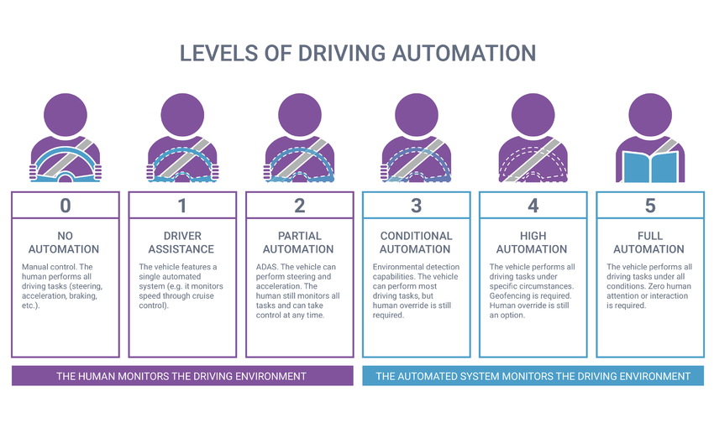
Introduction
Autonomous Vehicles (AV) are today’s reality but still driven under human supervision. The Society of Autonomous Engineers (SAE) defines following 6 levels of Driving Automation[2]:

Slide 4
Introduction
Despite all the advancements in technology, todays’ best AVs still hasn’t achieved Level-5 autonomy[1] that is “Full Automation”.
Most of the AVs drives with “Hands off but Eyes and Minds on” model.
Biggest challenge in achieving Level-5 autonomy (Full Automation) is “Pedestrian to Vehicle (P2V)” or “Vehicle to Pedestrian (V2P)”[6] communication.
The project objective is to develop an “Automaton for Human Gesture interaction with AVs”.

Slide 5
Introduction
In next slides, we shall:
Elaborate on problem statement by describing contextual information on AV domain.
Describe observations and conclusions from existing related work.
Explain the Automaton of proposed solution
Suggest enhancements for future work

Slide 6
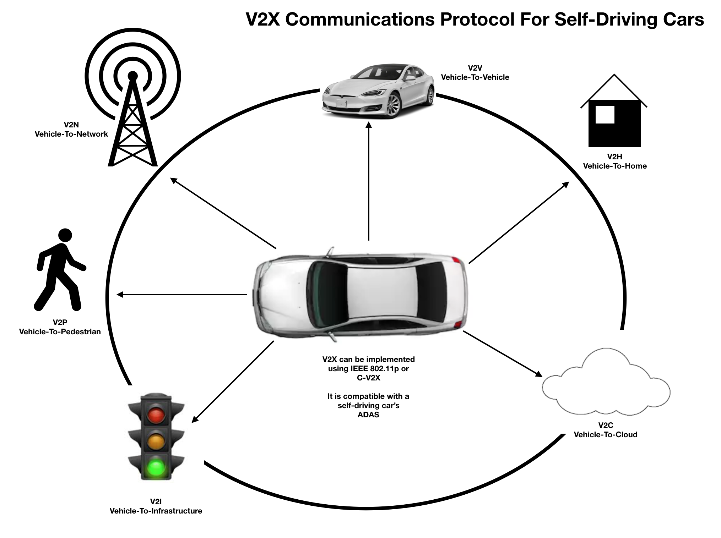
Problem Statement
AV uses several industry standard protocols to communicate with different physical and virtual environmental objects. These are namely[6]:
V2V Vehicle-to-Vehicle — Allows V2X enabled self-driving cars to communicate with one another.
V2I Vehicle-to-Infrastructure — Allows self-driving cars to get information from buildings, bridges, roads, traffic lights etc.
V2P Vehicle-to-Pedestrian — Makes use of pedestrian detection systems that can work with a car’s ADAS.
V2H Vehicle-to-Home — Smart homes can send and receive information directly from the car.
V2N Vehicle-to-Network — This is a mobile connection from the car to a carrier’s cellular network.
V2C Vehicle-to-Cloud — Provides direct access to cloud networks using secure TCP/IP connections

Slide 7
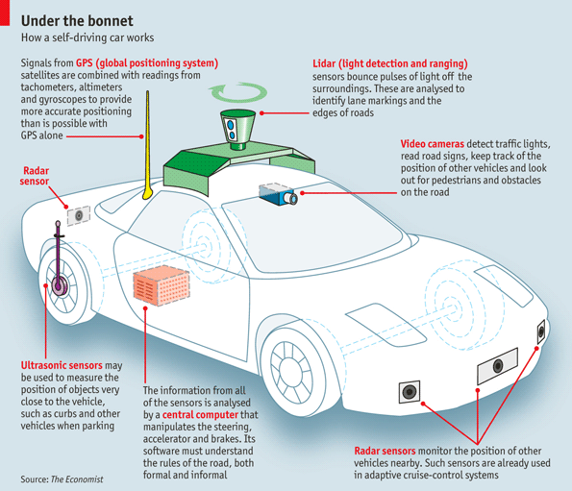
Problem Statement
Lot of research has been conducted on AV, it’s driver and passengers safety.
Advanced technologies are being employed for building external world object model and maps for autonomous driving of the vehicle.
Global Positioning System (GPS)
Light Detection and Ranging (LiDAR)
Radar Sensors
Ultrasonic Sensors
Cameras
Computer Vision
Neural Networks

Slide 8
Problem Statement
Yet there is no industry level technology that can understand the pedestrian gestures and translate them to AV driving system (P2V or V2P) accurately, Mainly due to:
Humans use several simple and complex gestures to interact with vehicle’s driver. Gestures complexity further increases due to cultural diversity among different societies. Same gesture can have different meanings in different culture.
Research by Rasouli and Tsotsos [5] on pedestrian behavior studies, identified 38 factors that plays significant role in the way pedestrians make decisions on the road.

Slide 9
Problem Statement
For example, while crossing a road where there is no designated crossing for pedestrians:
Adults use their eyes and hand gestures to communicate with vehicle driver.
Old people may just use their support stick
Children would just cross the road without any gesture communication.
We are proposing an Automata based solution for transitioning among different states of autonomous vehicle based on different hand gestures of pedestrian.

Slide 10
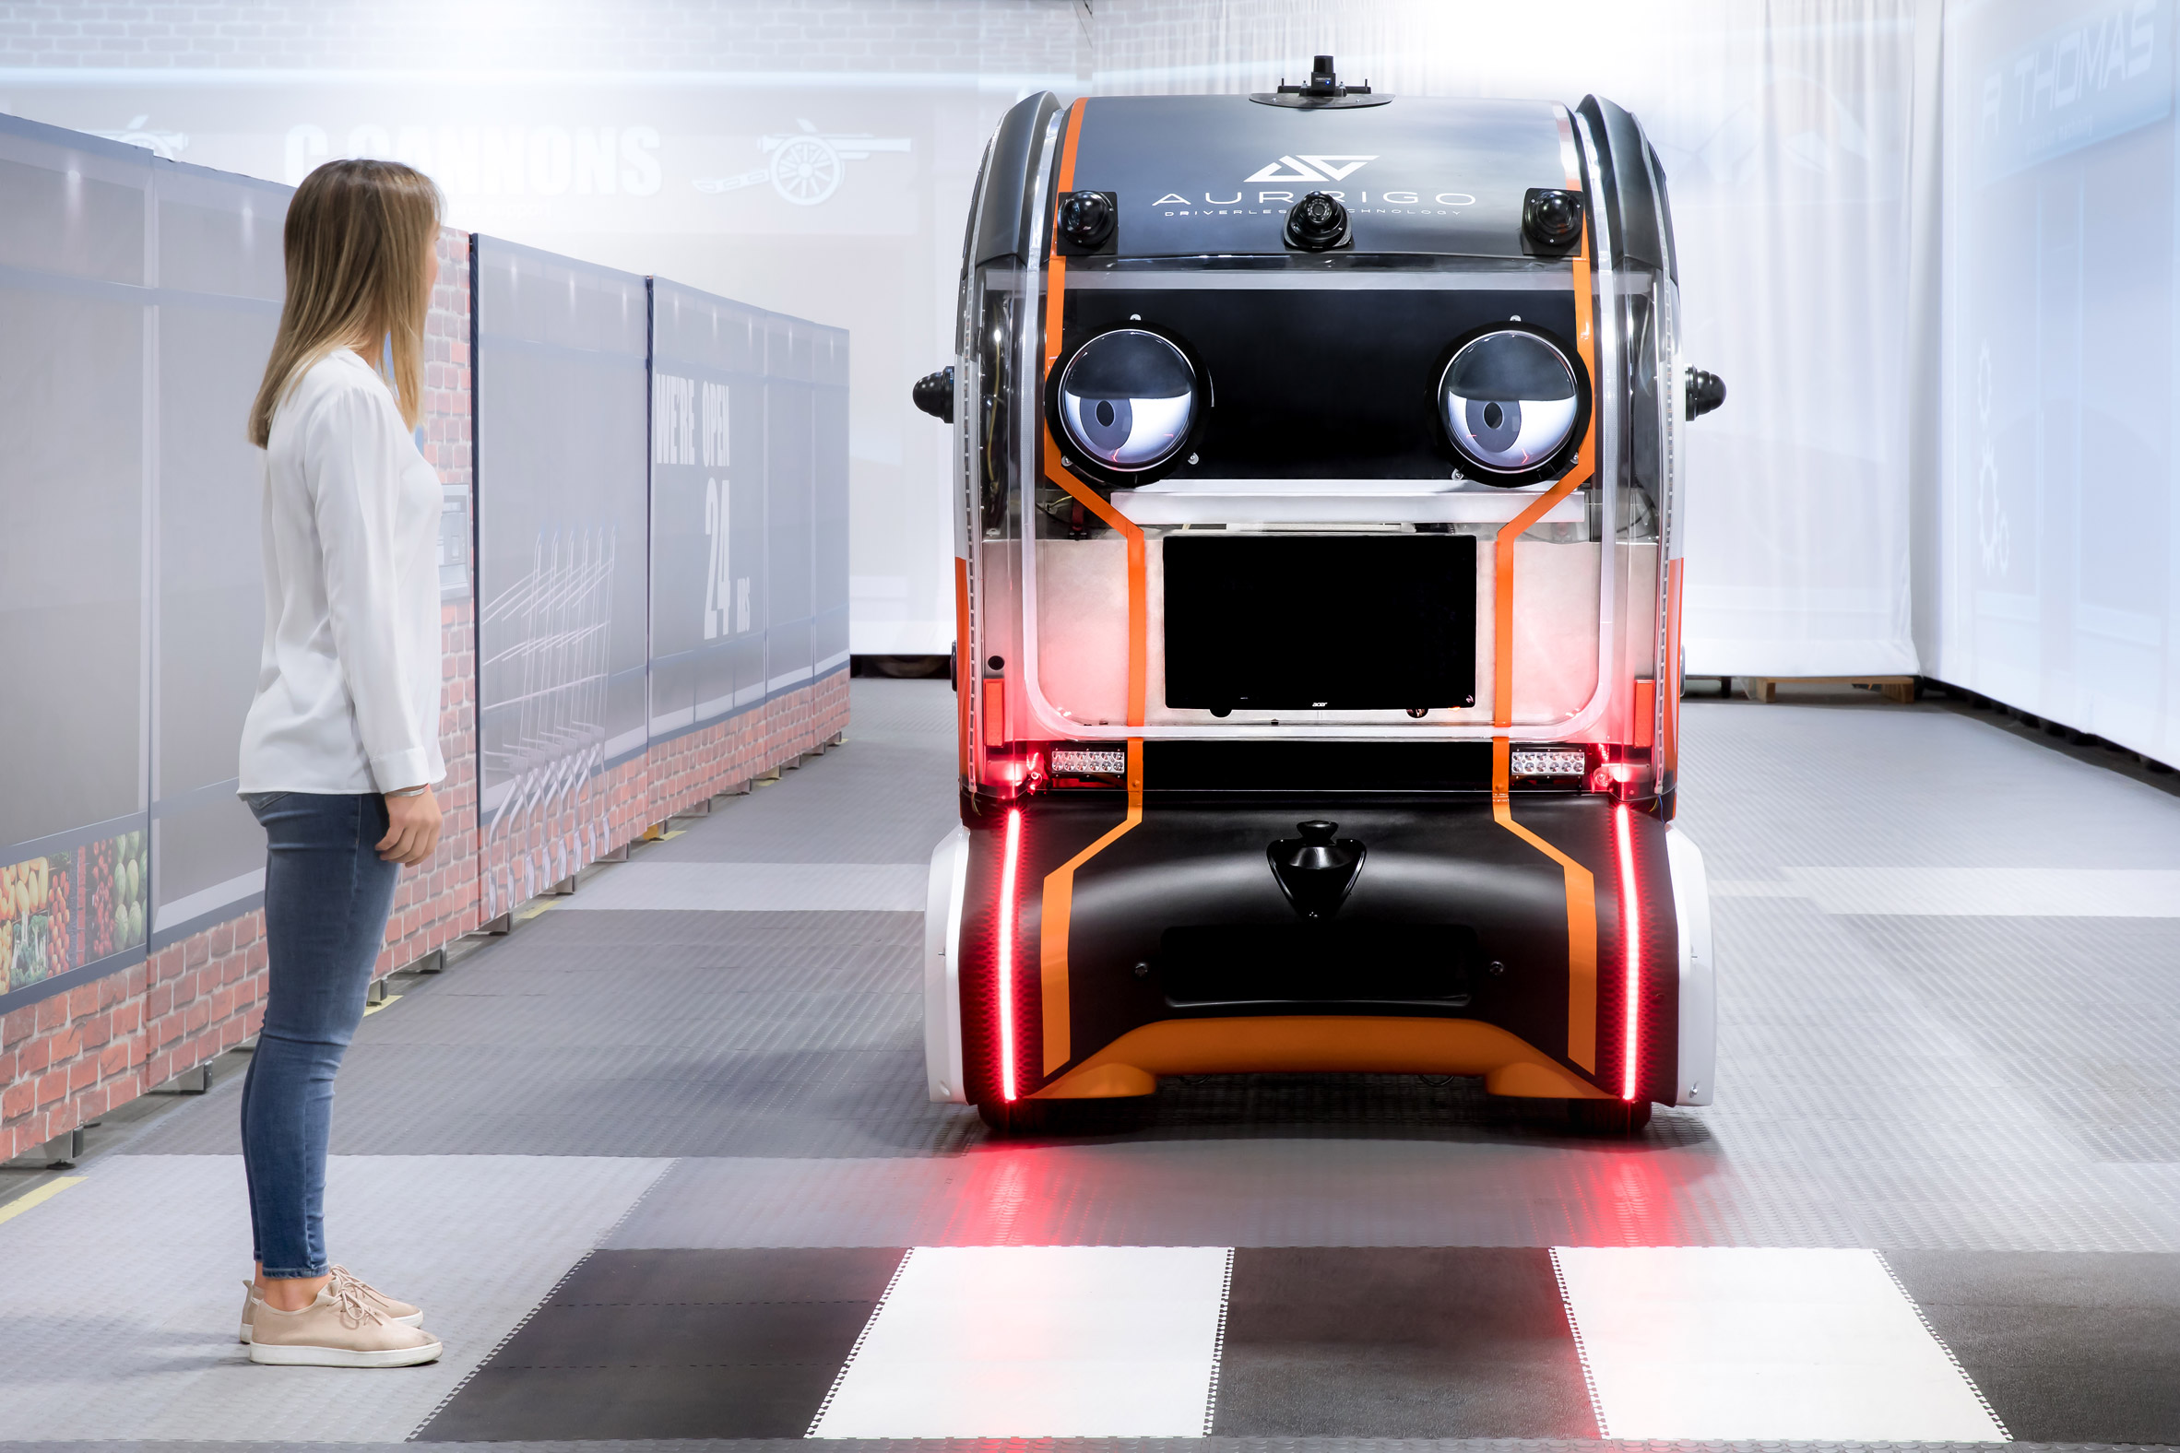
Literature Review
Jaguar and Land Rover[8] has created self-driving cars with eyes that are used to communicate with pedestrians when it's safe to cross in front of them.
Much like human drivers, the cars make eye contact with nearby pedestrians to acknowledge that they've seen them and are stopping to let them cross the road safely.
https://youtu.be/9ZQmW-qPsT0

Slide 11
Literature Review
Study conducted by Surabhi Gupta et. al. [3] on hand gestures similarities and differences in countries (UK, USA, Australia, Germany, India and China) concludes that:
At worksites, the hand gesture commands are found to be common across the countries.
However at road intersections hand gestures vary more broadly with overlap in gestures followed in some countries, but stark contrasts with other countries.

Slide 12
Literature Review
A recently conducted research on Pedestrian-Vehicle interaction by Daniela A. Ridel et al [4]. developed a machine learning model using Long Short-Term Memory (LSTM) technique to predict the movement of pedestrian based on head direction, ego-vehicle and past trajectories of pedestrian.
U. E. Manawadu et. al. [7] proposed an image recognition based model in a simulated environment for controlling AV steering Lateral and Longitudinal motions with hand gestures of it’s driver.

Slide 13
Literature Review
Recent work presented by Rasouli and Tsotsos [5] summarized pedestrian behavior studies, discussing interactions between pedestrians and autonomous vehicles, and also presented factors that pedestrians take into consideration when crossing streets.
The study discusses interactions between pedestrians and autonomous vehicles, and also presented factors that pedestrians take into consideration when crossing streets.
Authors further concludes that majority of behavioral studies involving autonomous vehicles are limited to small sample size, typically of 100 people of same demographics like University students.

Slide 14
Literature Review
On communication with road users, [5] found that this is a rarely researched area. Majority of research failed to conclude about the effective mode of communication between informative vs advisory, that is display instructions on LCDs or light up lights to communicate vehicle intention to pedestrian.
They also studied the pedestrian intention prediction algorithms and concluded that they are very limited due to lack of contextual information or because usage of data from a simulated environment. Hence they are not able to yet predict the intention with acceptable accuracy.

Slide 15
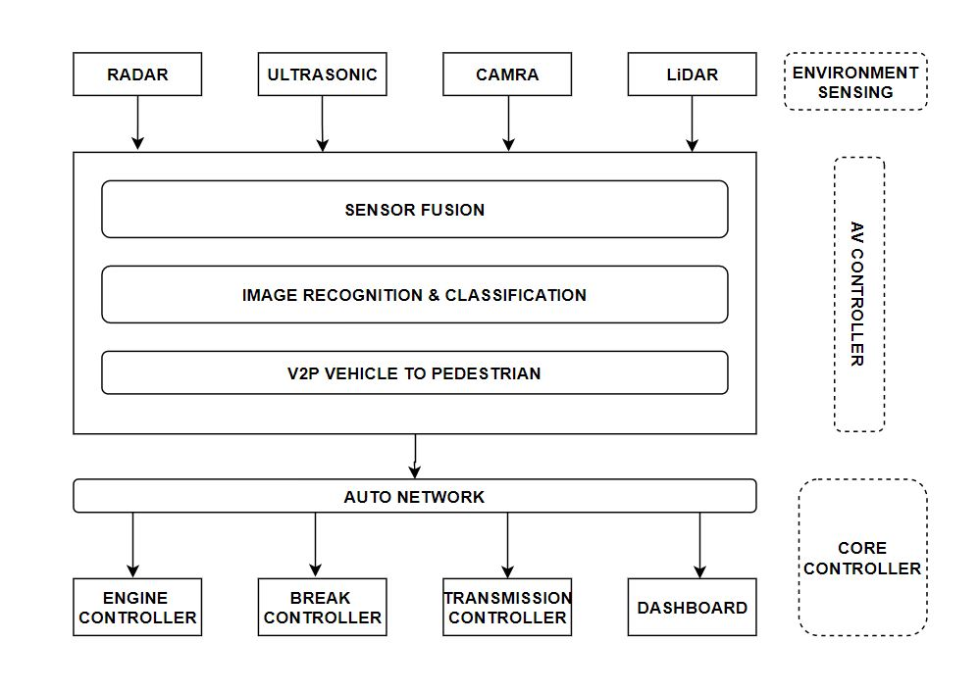
Proposed Model Context Diagram

Slide 16
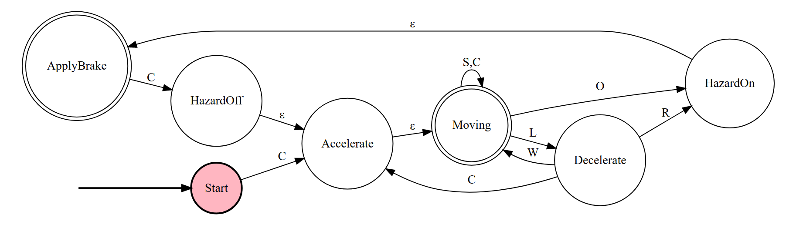
Proposed Model Vehicle 2 Pedestrian E-NFA
C : Road Clear, L : Looking, O : Obstacle, R : Raise Hand, W : Waive Hand, S : Standing
Σ = {C, L, O, R, W, S}
F = {Moving, ApplyBrake}

Slide 17
Proposed Model Vehicle 2 Pedestrian E-NFA
C : Road Clear, L : Looking, O : Obstacle, R : Raise Hand, W : Waive Hand, S : Standing
Σ = {C, L, O, R, W, S}
F = {Moving, ApplyBrake} Example Accepting String: C L R

Slide 18
Future Work
We suggest enhancing this automaton by including more inputs, especially of:
Eye movement of pedestrian.
Multiple gesture inputs from a group of pedestrians.
Cultural differentiators, for example “Go” gesture in UK is indicated by “Right Arm up and Waving” while in Australia it is “Extend one Arm and Wave another Arm” in the direction of traffic.
Traffic controllers hand gesture movements.

Slide 19
References
https://www.autopilotreview.com/cars-with-autopilot-self-driving/
https://www.synopsys.com/automotive/autonomous-driving-levels.html
Surabhi Gupta, Maria Vasardani, Stephan Winter Conventionalized gestures for the interaction of people in traffic with autonomous vehicles, 2016
Daniela A. Ridel1;2, Nachiket Deo2, Denis Wolf1, and Mohan Trivedi2 Understanding Pedestrian-Vehicle Interactions with Vehicle Mounted Vision: An LSTM Model and Empirical Analysis, 2019
Autonomous vehicles that interact with pedestrians: A survey of theory and practice https://arxiv.org/abs/1805.11773, 2019
https://medium.com/self-driving-cars/improving-self-driving-car-safety-and-reliability-with-v2x-protocols-1408082bae54, 2018
A Hand Gesture based Driver-Vehicle Interface to Control Lateral and Longitudinal Motions of an Autonomous Vehicle, https://www.researchgate.net/publication/309391751_A_Hand_Gesture_based_Driver-Vehicle_Interface_to_Control_Lateral_and_Longitudinal_Motions_of_an_Autonomous_Vehicle, 2016
https://www.dezeen.com/2018/09/04/jaguar-land-rovers-prototype-driverless-car-makes-eye-contact-pedestrians-transport/

Slide 20
Thank you
Questions?

